Slide 1
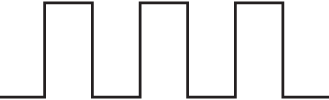
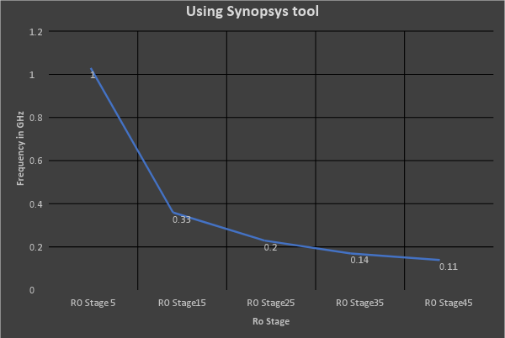
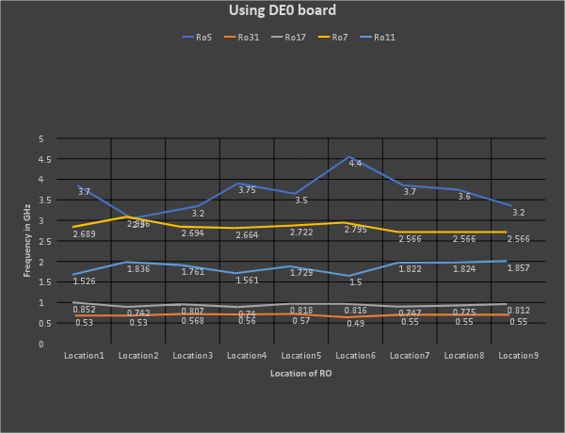

FPGA Reliability and Security
Ahmed Foisal , Mian Riaz-ul Haque, Islam Syful
Dependable System laboratory , Graduate School of Information Science, Nara Institute of Science and Technology (NAIST)
Background : FPGA’s are one of the modern reconfigurable platforms widely used today and statistical reports show that these are on of the top five counterfeited electronic components. Hence, reliability and security of these devices are now much more concerned issues due to the increased use of counterfeit electronic components in industry and government.
IC used in home
appliance
Telecommunication,
Military etc.
Electronics Garbage
IC in
Recycling
Recycled
IC
Recycled IC
at Critical
Application
Flow of FPGA recycling process with it effects on critical applications
Motivation : Design and implement a prototype to detect recycled FPGA for reducing probability of catastrophic consequences on safety critical applications like Defense, Aerospace , Medical , Nuclear plant etc.
Proposed System Architecture
Ring Oscillator(RO) is composed of odd number of inverters with feedback loop and a NAND gate for enabling purpose.
The frequency of RO is determined by the delay of the inverters.
Host PC
Enable
output
Amplitude
Display
Recycled
FPGA
Ring Oscillator
Time
Master FPGA
R0
R0
For n-stage inverter, the oscillation frequency f will be 1/(2×n×t_{d}). Where t_{d} is delay of the inverter
Due to FPGA aging the frequency of RO degrades over time.
This prototype establishes a measuring environment for detecting recycled FPGA using frequency of the RO.
Host PC controls the Master FPGA and retrieves data from Device under test (DUT) using Raspberry Pi module.
Therefore, Collected data will fed under test using Machine Learning algorithm.
Finally, Display module will show the test result graphically whether the FPGA is recycled or not.
Raspberry pi
R0
R0
Frequency
RO
Device under Analysis
Suspicious FPGA
Proposed Measurement environment
System Flowchart
Result Analysis
Finger print Generation
Synopsys CAD tools was used to observe the frequency degradation of Ring Oscillator (RO) as the number of inverter stages increasing.
New sample IC
Placed the inverter based RO
DUT’s Measurement
Construct Frequency array of RO of different location. F_{array} =[f₁, f₂, …f_{k}]
DUT
Fingerprint generation using Machine Learning
Placed the inverter based RO
Construct Frequency array of RO of different location. F_{array} =[f₁, f₂, …f_{k}]
Altera Cyclone III board was used for hardware observations. The frequencies of same stage Ring Oscillator were observed in different FPGA locations – Varying of the result focuses the FPGA aging .
unused
NO
Test FPGA Aged
Using Ring Oscillator of different location on the FPGA
Machine learning technique is used for the decision of recycled FPGA
Yes
Recycled
Flow of measurement using RO and Machine Learning
@Dependable System Laboratory, School of Information Science , Nara Institute of Science and Technology

Slide 2
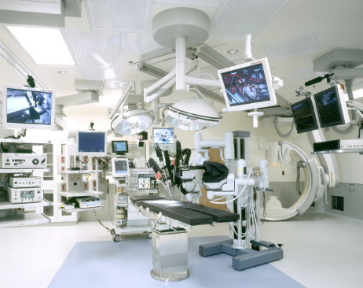
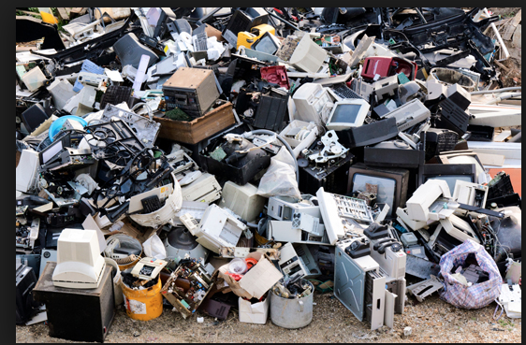
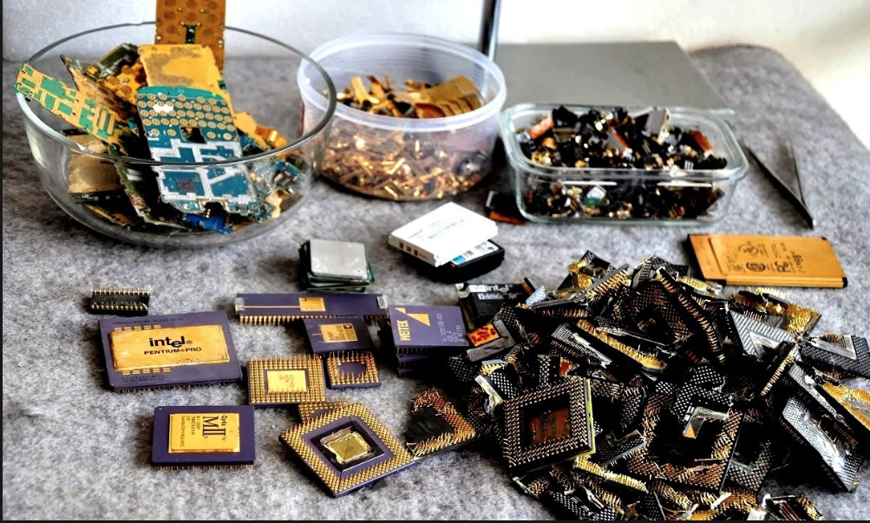
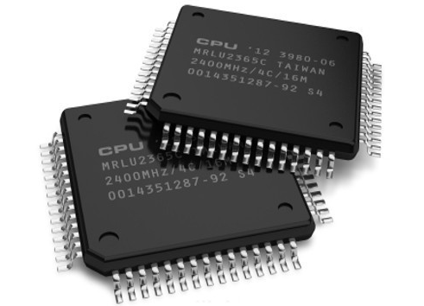
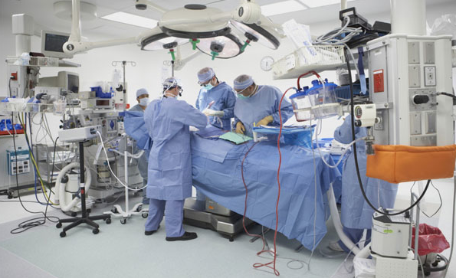
FPGA Reliability and Security
Ahmed Foisal , Mian Riaz-ul Haque, Islam Syful
Dependable System laboratory , Graduate School of Information Science, Nara Institute of Science and Technology (NAIST)
Background : FPGA’s are one of the modern reconfigurable platforms widely used today and statistical reports show that these are on of the top five counterfeited electronic components. Hence, reliability and security of these devices are now much more concerned issues due to the increased use of counterfeit electronic components in industry and government.
Malfunction
Flow of FPGA recycling process with it effects on critical applications
Motivation : Design and implement a prototype to detect recycled FPGA for reducing probability of catastrophic consequences on safety critical applications like Defense, Aerospace , Medical , Nuclear plant etc.
Proposed System Architecture
Ring Oscillator(RO) is composed of odd number of inverters with feedback loop and a NAND gate for enabling purpose.
The frequency of RO is determined by the delay of the inverters.
Host PC
Enable
output
Amplitude
Display
AES
Ring Oscillator
Time
Recycled
FPGA
For n-stage inverter, the oscillation frequency f will be 1/(2×n×t_{d}). Where t_{d} is delay of the inverter
Due to FPGA aging the frequency of RO degrades over time.
This prototype establishes a measuring environment for detecting recycled FPGA using frequency of the RO.
Host PC controls the Master FPGA and retrieves data from Device under test (DUT) using Raspberry Pi module.
Therefore, Collected data will fed under test using Machine Learning algorithm.
Finally, Display module will show the test result graphically whether the FPGA is recycled or not.
Master FPGA
R0
R0
Raspberry pi
R0
R0
Power
time
Device under Analysis
Suspicious FPGA
Proposed Measurement environment
Proposed Algorithm
Result Analysis
Finger print Generation
Synopsys CAD tools was used to observe the frequency degradation of Ring Oscillator (RO) as the number of inverter stages increasing.
New sample IC
Placed the inverter based RO
DUT’s Measurement
Construct Frequency array of RO of different location. F_{array} =[f₁, f₂, …f_{k}]
DUT
Fingerprint generation using Machine Learning
Placed the inverter based RO
Construct Frequency array of RO of different location. F_{array} =[f₁, f₂, …f_{k}]
Altera Cyclone III board was used for hardware observations. The frequencies of same stage Ring Oscillator were observed in different FPGA locations – Varying of the result focuses the FPGA aging .
unused
NO
Test FPGA Aged
Using Ring Oscillator of different location on the FPGA
Machine learning technique is used for the decision of recycled FPGA
Yes
Recycled
Flow of measurement using RO and Machine Learning
@Dependable System Laboratory, School of Information Science , Nara Institute of Science and Technology

Slide 3
IC used in home
appliance
Telecommunication,
Military etc.
Electronics Garbage
IC in
Recycling
Recycled
IC
Recycled IC
at Critical
Application

